Slide 1
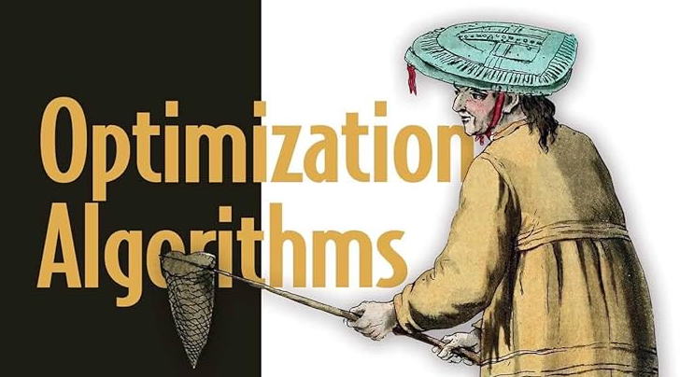

Optimization Algorithms
L3: Blind Search Algorithms
Alaa Khamis, Ph.D
AI and Smart Mobility Professor at KFUPM and Ex- GM Technical Leader
This lecture is based on Part-I Deterministic Search Algorithms of the textbook: Optimization Algorithms: AI techniques for design, planning, and control problems, Manning Publication, 2024.
2025 © Dr. Alaa Khamis

Slide 2
Outline
Introduction to Graphs
Graph Search Methods
Uninformed/Blind Search
Graph Traversal Algorithms
Shortest Path Algorithms
Notes:
2

Slide 3
Outline
Introduction to Graphs
Graph Search Methods
Uninformed/Blind Search
Graph Traversal Algorithms
Shortest Path Algorithms
Notes:
3

Slide 4
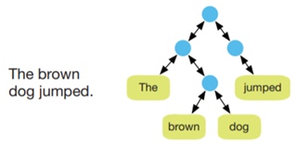
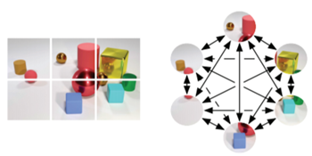
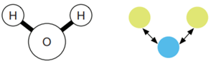
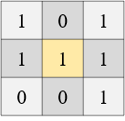
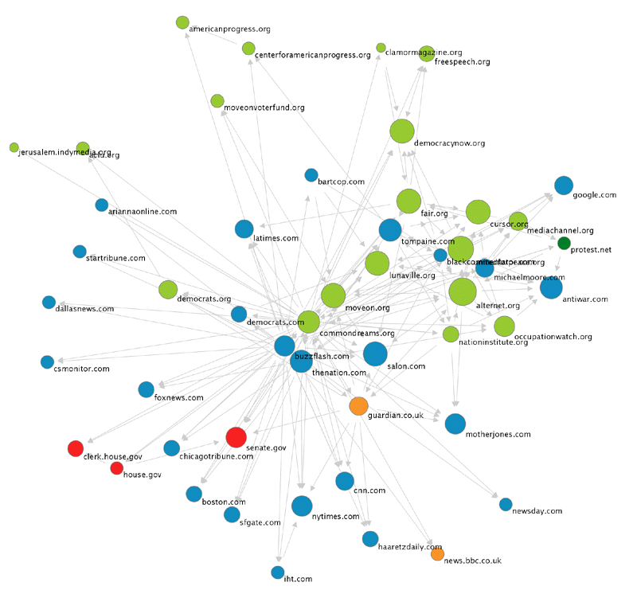
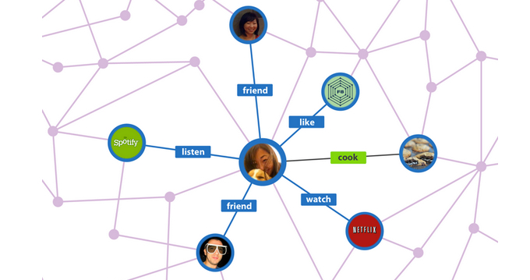
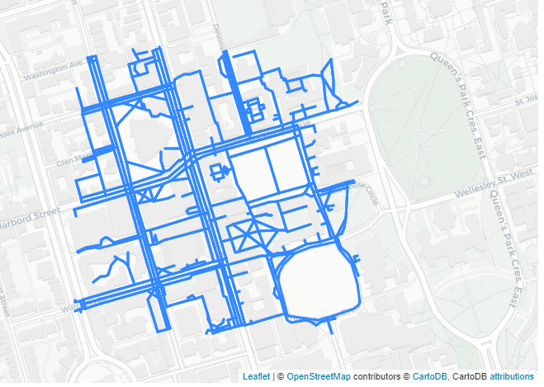
Introduction to Graphs
What is a Graph?
A graph is a structured datatype that consists of 3 sets, namely, vertices/nodes (entities that hold information), edges (connections between nodes that can also hold information) and a set representing relations between vertices and edges.
A molecule
Sentence and Parse Tree
Image/Grid Graph
Fully Connected Scene Graph
Web Graph
Social Network Graph
Road Network Graph
Notes:
4

Slide 5
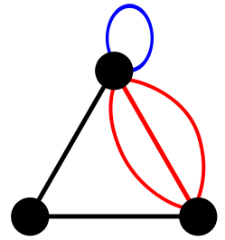
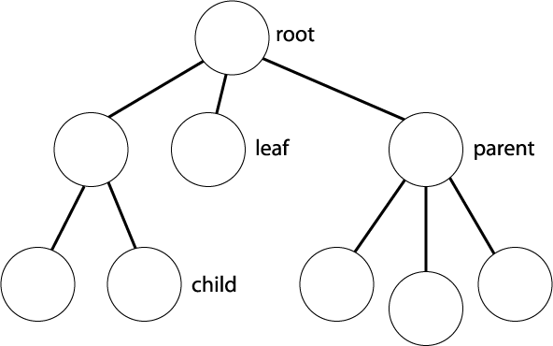
Introduction to Graphs
What is the difference between tree and graph?
A tree is a specialized case of a graph. A tree is a connected graph with no circuits and no self loops.
Apex node
This is a graph not a tree
Tree
Notes:
5

Slide 6
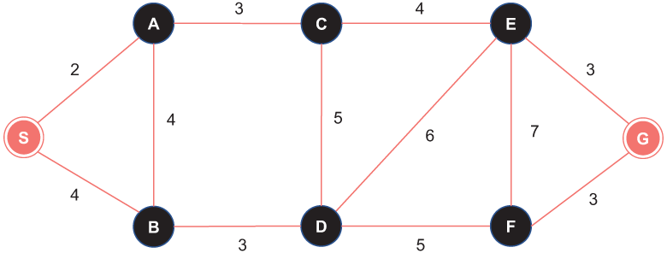
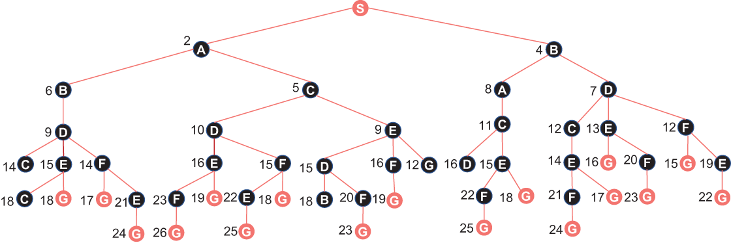
Introduction to Graphs
What is the difference between tree and graph?
Converting graph into a tree
Notes:
6

Slide 7
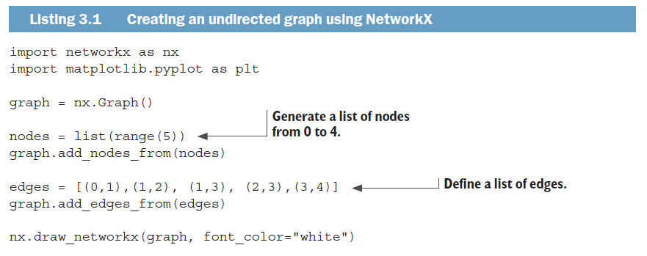
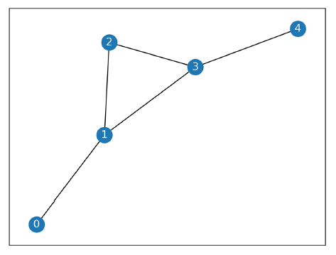
Introduction to Graphs
Graph Types: Undirected Graph
Code: https://github.com/Optimization-Algorithms-Book/Code-Listings/tree/main/Chapter%203
Notes:
7

Slide 8
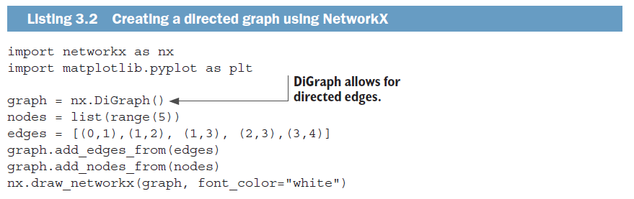
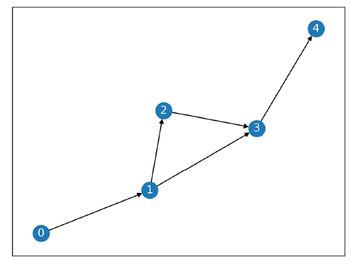
Introduction to Graphs
Graph Types: Directed Graph
Code: https://github.com/Optimization-Algorithms-Book/Code-Listings/tree/main/Chapter%203
Notes:
8

Slide 9
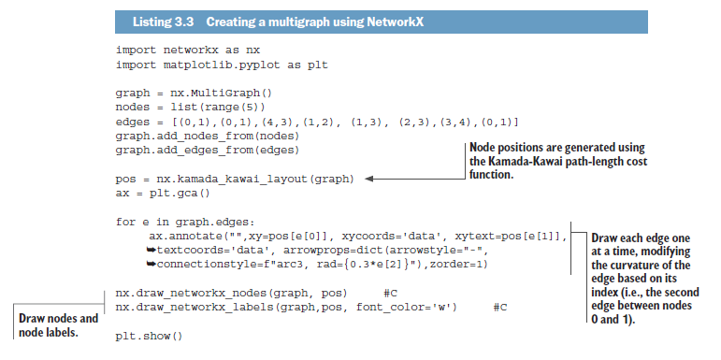
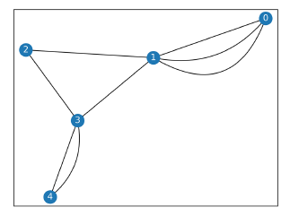
Introduction to Graphs
Graph Types: Multigraph Graph
Code: https://github.com/Optimization-Algorithms-Book/Code-Listings/tree/main/Chapter%203
Notes:
9

Slide 10
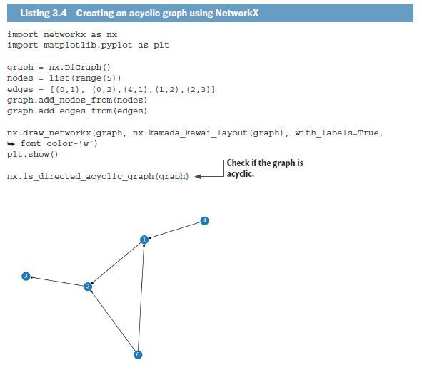
Introduction to Graphs
Graph Types: Acyclic Graph
Code: https://github.com/Optimization-Algorithms-Book/Code-Listings/tree/main/Chapter%203
Notes:
10

Slide 11
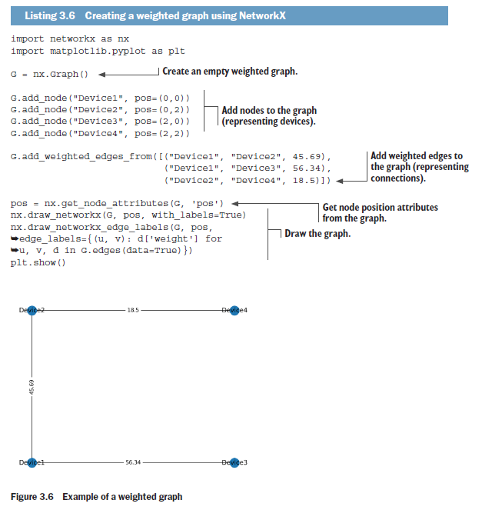
Introduction to Graphs
Graph Types: Weighted Graph
Code: https://github.com/Optimization-Algorithms-Book/Code-Listings/tree/main/Chapter%203
Notes:
11

Slide 12
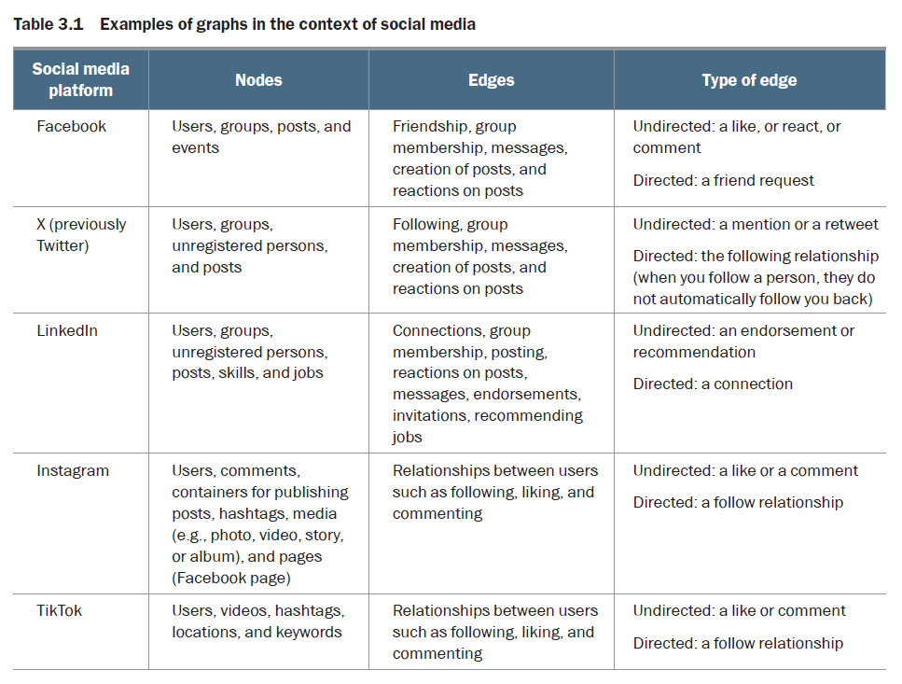





Introduction to Graphs
Graph Types: Examples
Notes:
12

Slide 13
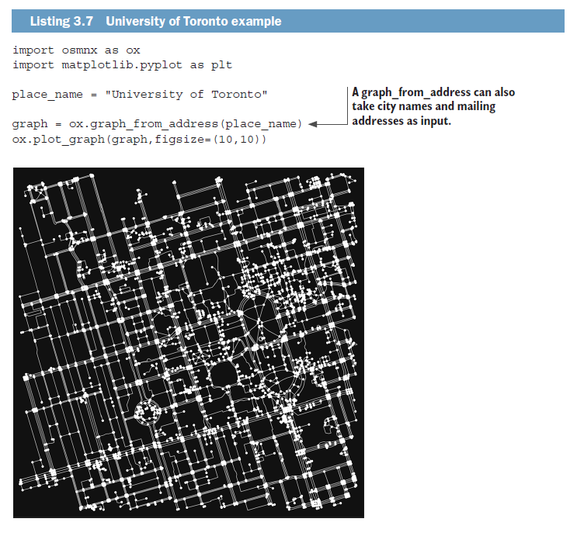
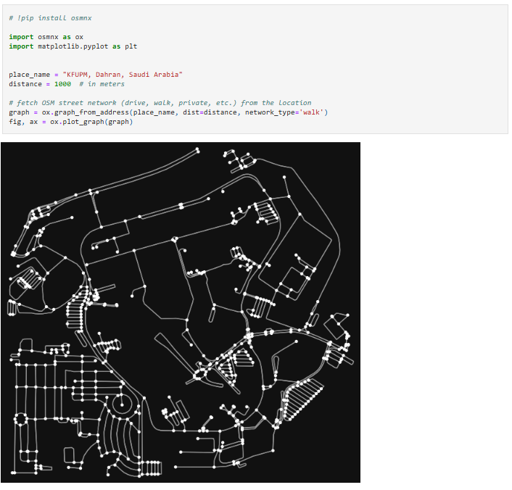
Introduction to Graphs
From Road Network to Graph
[Code]
Notes:
13

Slide 14
Outline
Introduction to Graphs
Graph Search Methods
Uninformed/Blind Search
Graph Traversal Algorithms
Shortest Path Algorithms
Notes:
14

Slide 15
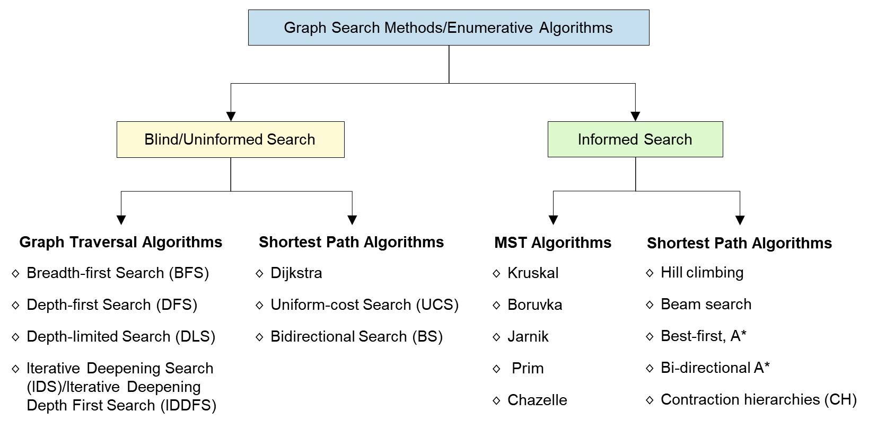
Graph Search Methods
Notes:
15

Slide 16
Outline
Introduction to Graphs
Graph Search Methods
Uninformed/Blind Search
Graph Traversal Algorithms
Shortest Path Algorithms
Notes:
16

Slide 17
Uninformed/Blind Search
Blind Search
Graph Traversal Algorithms
Shortest Path Algorithms
Breadth-first Search (BFS)
Depth-first Search (DFS)
Dijkstra
Uniform-cost Search (UCS)
Bidirectional Search (BS)
Notes:
17

Slide 18
Outline
Introduction to Graphs
Graph Search Methods
Uninformed/Blind Search
Graph Traversal Algorithms
Shortest Path Algorithms
Notes:
18

Slide 19
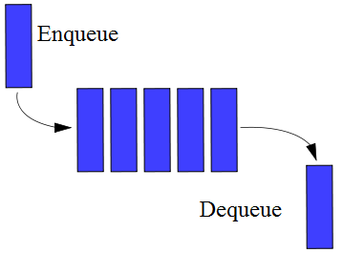
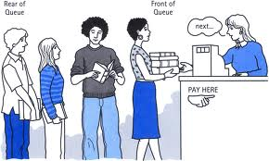
Graph Traversal Algorithms
Breadth-first Search (BFS)
BFS uses the queue as data structure.
Queue is a First-In-First-Out (FIFO) data structure.
A FIFO means that the node that has been sitting on the queue for the longest amount of time is the next node to be expanded.
Notes:
19

Slide 20
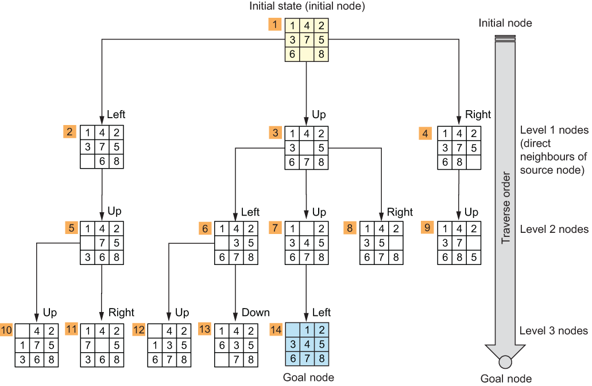
Graph Traversal Algorithms
BFS: 8-Puzzle Problem
Notes:
20

Slide 21
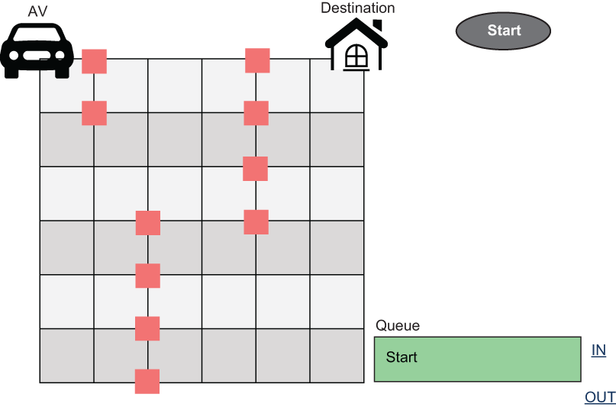
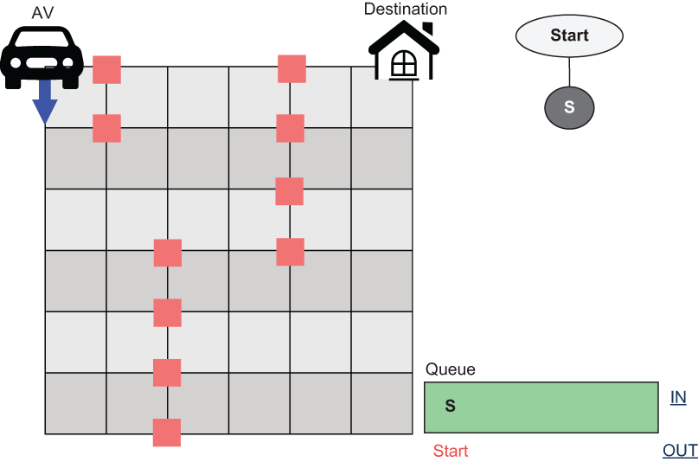
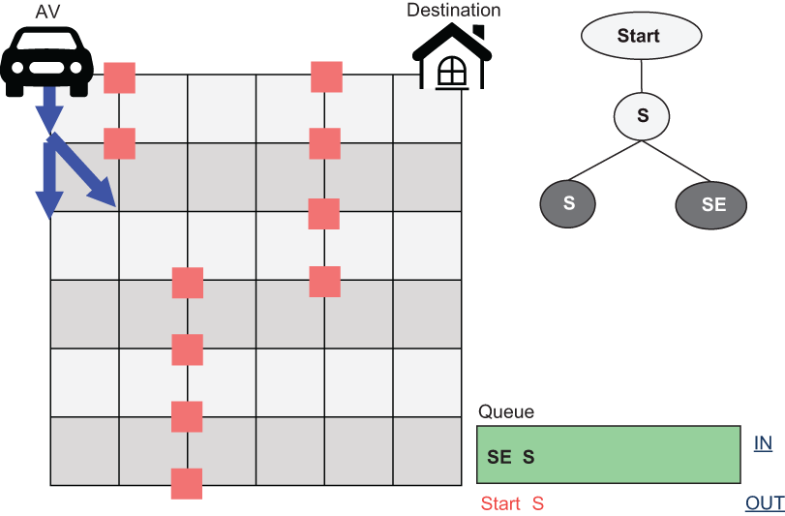
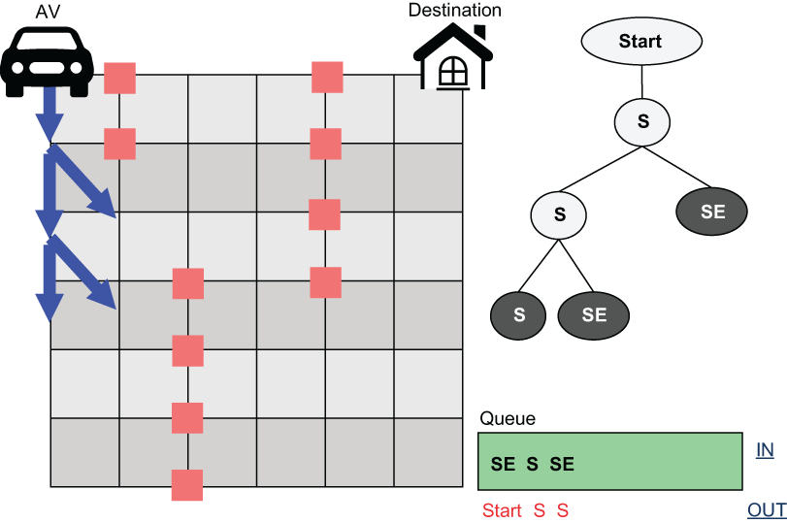
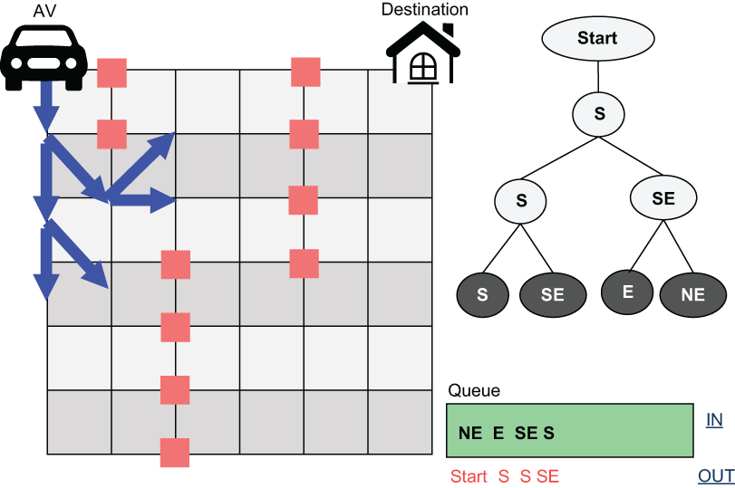
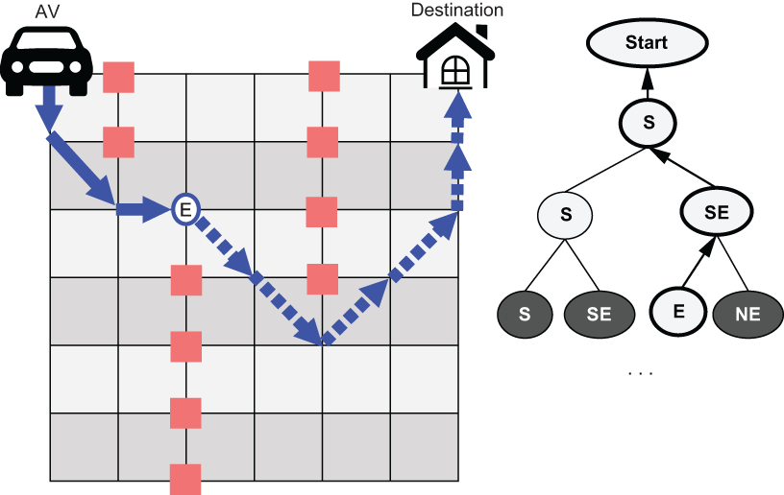
Graph Traversal Algorithms
BFS: Path Planning Problem
Notes:
21

Slide 22
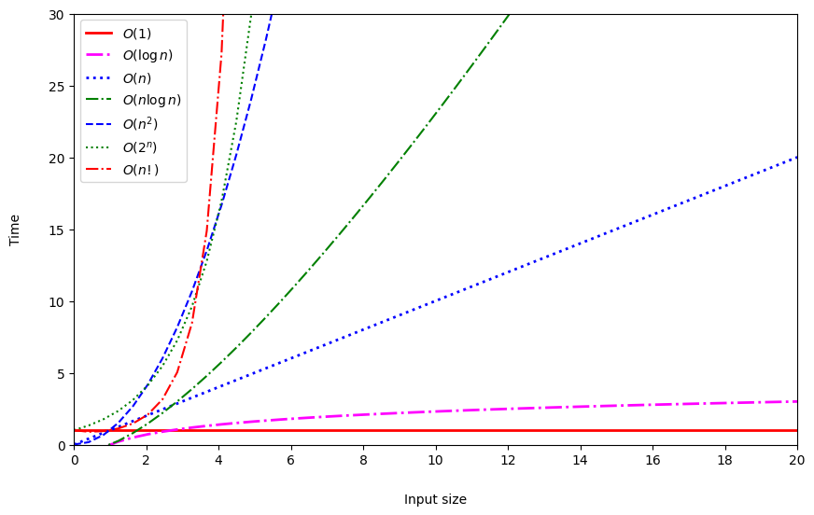
Graph Traversal Algorithms
BFS: Big-O
Big O notation describes the performance or complexity of an algorithm, usually under the worst-case scenario. Big O notation helps us answer the question, “Will the algorithm scale?”
Notation | Name | To remember ☺
O(1) | Constant | O(yeah)
O(log n) | Logarithmic | O(nice)
O(n) | Linear | O(ok)
O(n²) | Polynomial or algebraic | O(my)
O(2^{n}) | Exponential | O(no)
O(n!) | Factorial | O(mg)
Notes:
22

Slide 23
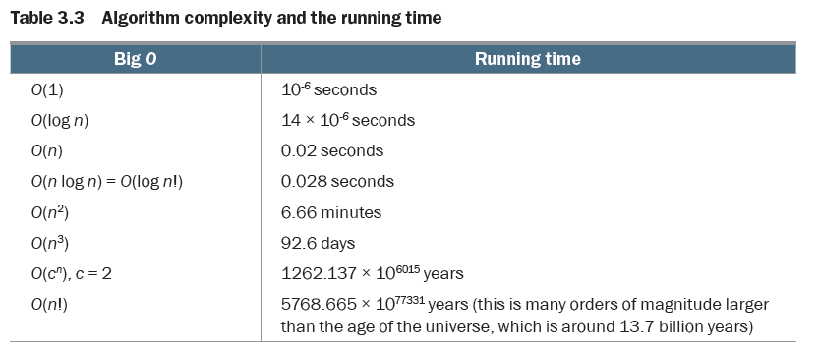
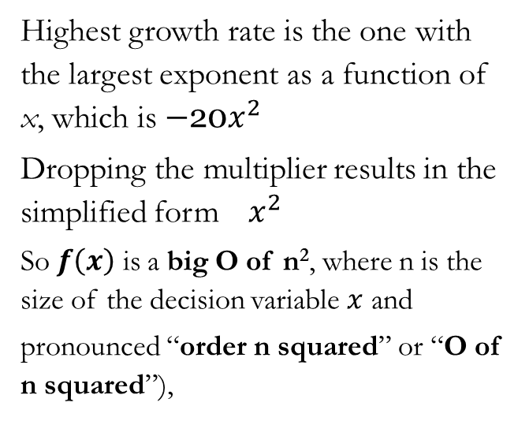
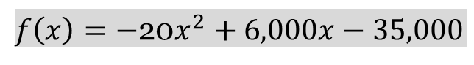
Graph Traversal Algorithms
BFS: Big-O
Assume a computer with a processor speed of one million operations per second is used to handle a problem of size n = 20,000. The following table shows the running time according to the big O notation of the algorithm used to solve this problem.
Example: Ticket pricing problem
$f\left(x\right)=−$20$x^{2}+6,000x−35,000$
Highest growth rate is the one with the largest exponent as a function of x, which is $−$20$x^{2}$
Dropping the multiplier results in the simplified form ${ x}^{2}$
So $f\left(x\right)$ is a big O of n², where n is the size of the decision variable $x$ and
pronounced “order n squared” or “O of n squared”),
The time complexity of BFS is O(b^{d}).
Notes:
23

Slide 24
Graph Traversal Algorithms
BFS: Space Complexity
In BFS, every node generated must remain in memory.
The number of nodes generated is at most O(b^{d}), where b represents the maximum branching factor for each node (i.e., the number of children the node has) and d is the depth one must expand to reach the goal.
In the previous example, with E as a goal node (b=2, d=3), the total number of traversed nodes is 2³=8, including the start node.
Notes:
24

Slide 25
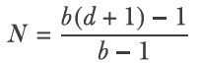
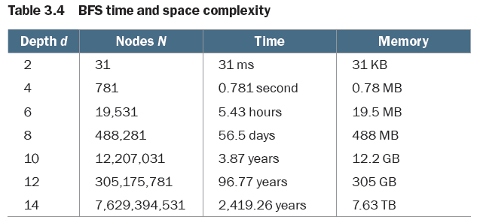
Graph Traversal Algorithms
BFS: Time and Space Complexity
Let’s consider a graph with a constant branching factor b = 5, nodes of size 1 KB, and a limit of 1,000 nodes scanned per second. The total number of nodes N is given by the following equation:
The following table shows the time and memory requirements to traverse this graph using BFS.
Notes:
25

Slide 26
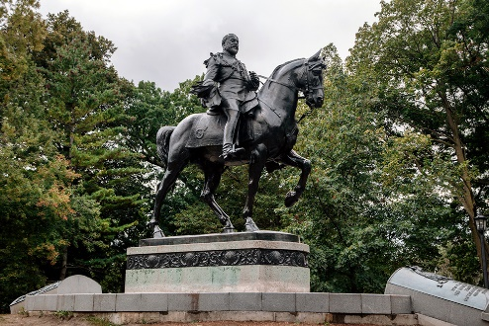
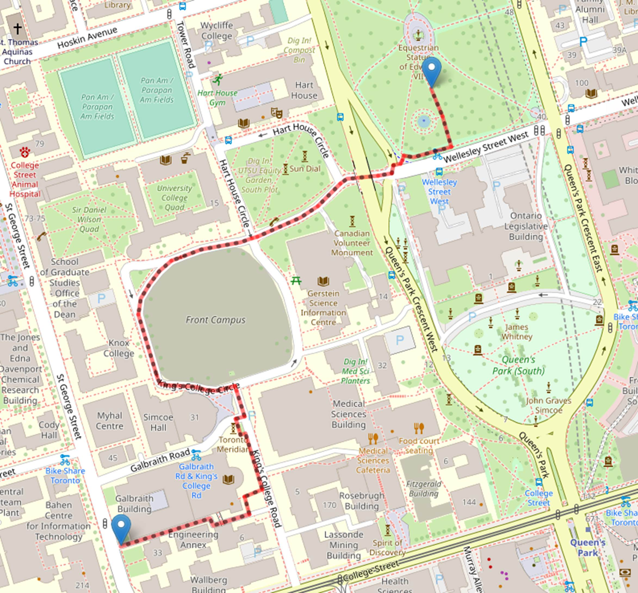

Graph Traversal Algorithms
Breadth-first Search (BFS): UofT Routing Problem
source_point = (43.664527, -79.392442)
# King Edward VII Equestrian Statue
destination_point = (43.659659, -79.397669)
# Bahen Centre for Information Technology at UofT
Check: https://github.com/Optimization-Algorithms-Book/Code-Listings/blob/main/Chapter%203/Listing%203.11_comparison.ipynb
Notes:
26

Slide 27
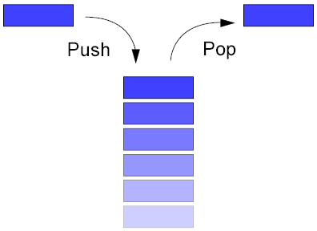

Graph Traversal Algorithms
Depth-first Search (DFS)
DFS uses the stack as data structure.
Stack is a Last-In-First-Out (LIFO) data structure.
The stack contains the list of discovered nodes. The most recent discovered node is put (pushed) on top of the LIFO stack.
The next node to be expanded is then taken (popped) from the top of the stack and all of its successors are added to the stack.
Stack (LIFO)
http://wiki.ugcnet4cs.in/t/Stack
Notes:
27

Slide 28
Graph Traversal Algorithms
DFS: Complexity
Depth first search usually requires a considerably less amount of memory that BFS.
This is mainly because DFS does not always expand out every single node at each depth.
However the DFS could continue down an unbounded branch forever even if the goal is not located on that branch.
Time Complexity: O(b^{d}) → terrible if d is much larger than b but if solutions are dense, may be much faster than BFS.
Space Complexity: O(bd), i.e., linear space!
Notes:
28

Slide 29
Graph Traversal Algorithms
DFS: Complexity
Low memory requirement.
Full state space search in that every node is processed, i.e, it’s exhaustive within its set limits.
Could get stuck exploring infinite paths.
Used if there are many solutions and you need only one.
Notes:
29

Slide 30
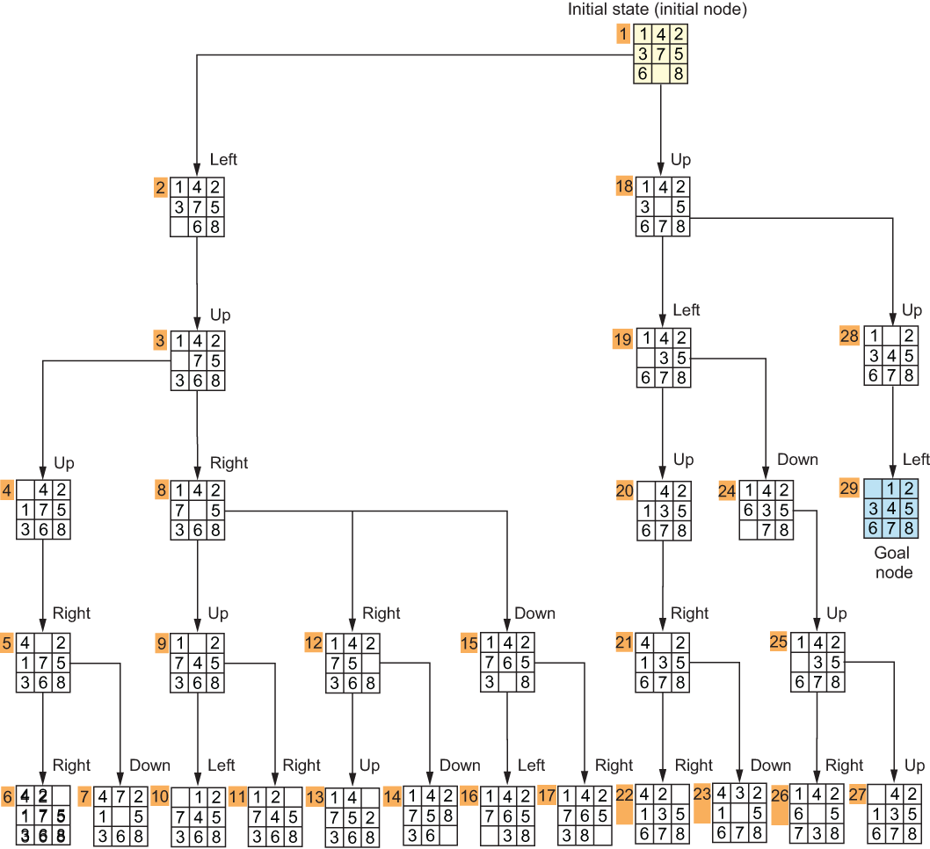
Graph Traversal Algorithms
DFS: 8-Puzzle Problem
Notes:
30

Slide 31
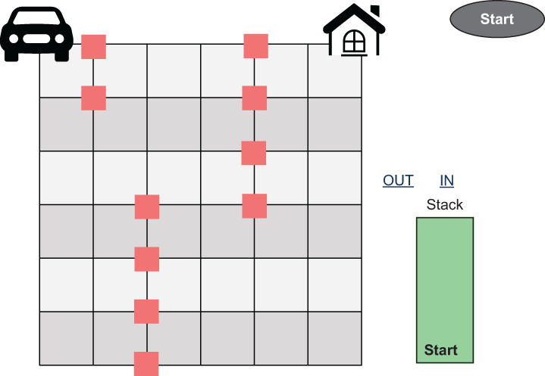
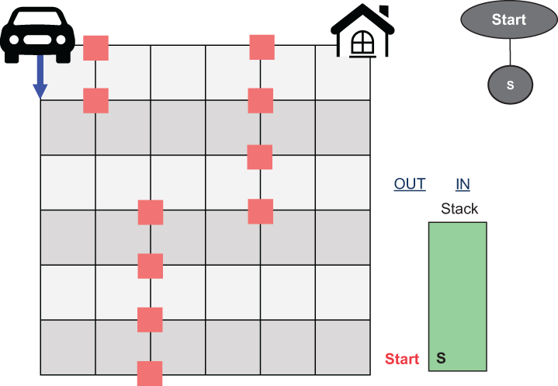
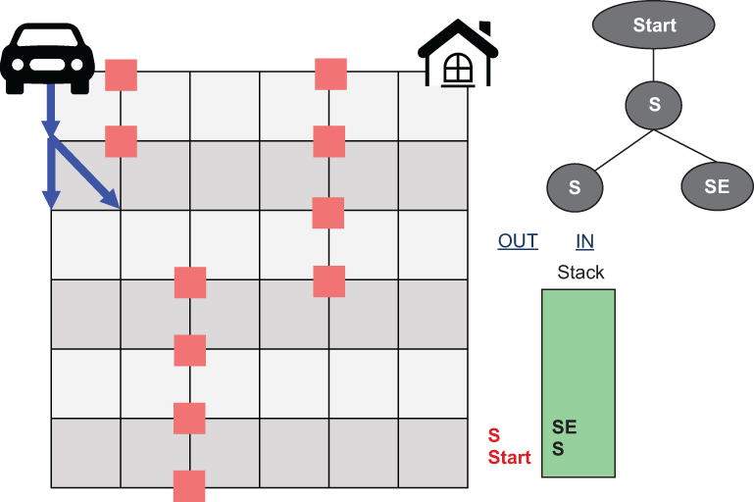
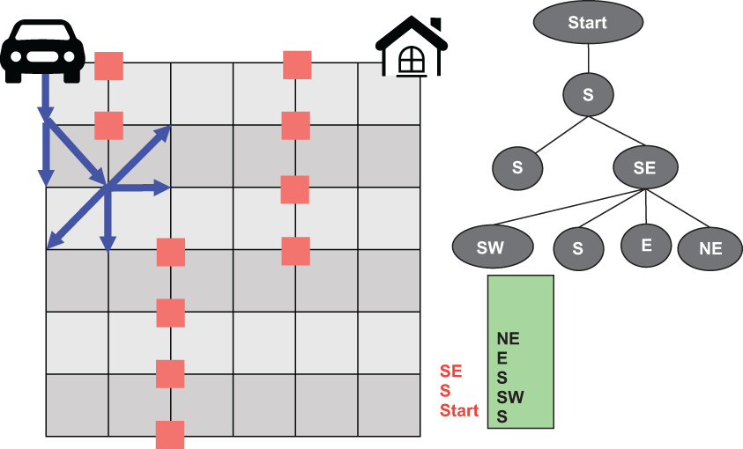
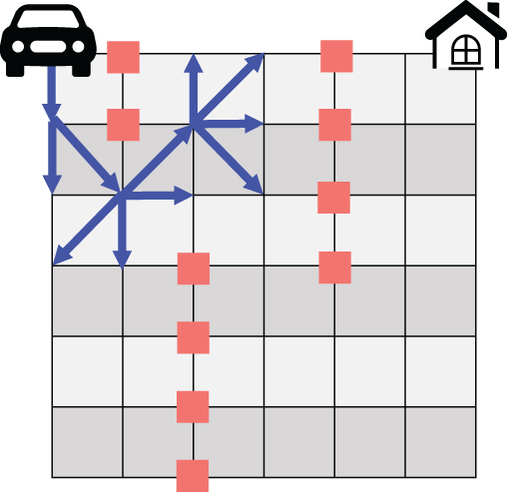
Graph Traversal Algorithms
DFS: Path Planning Problem
Notes:
31

Slide 32
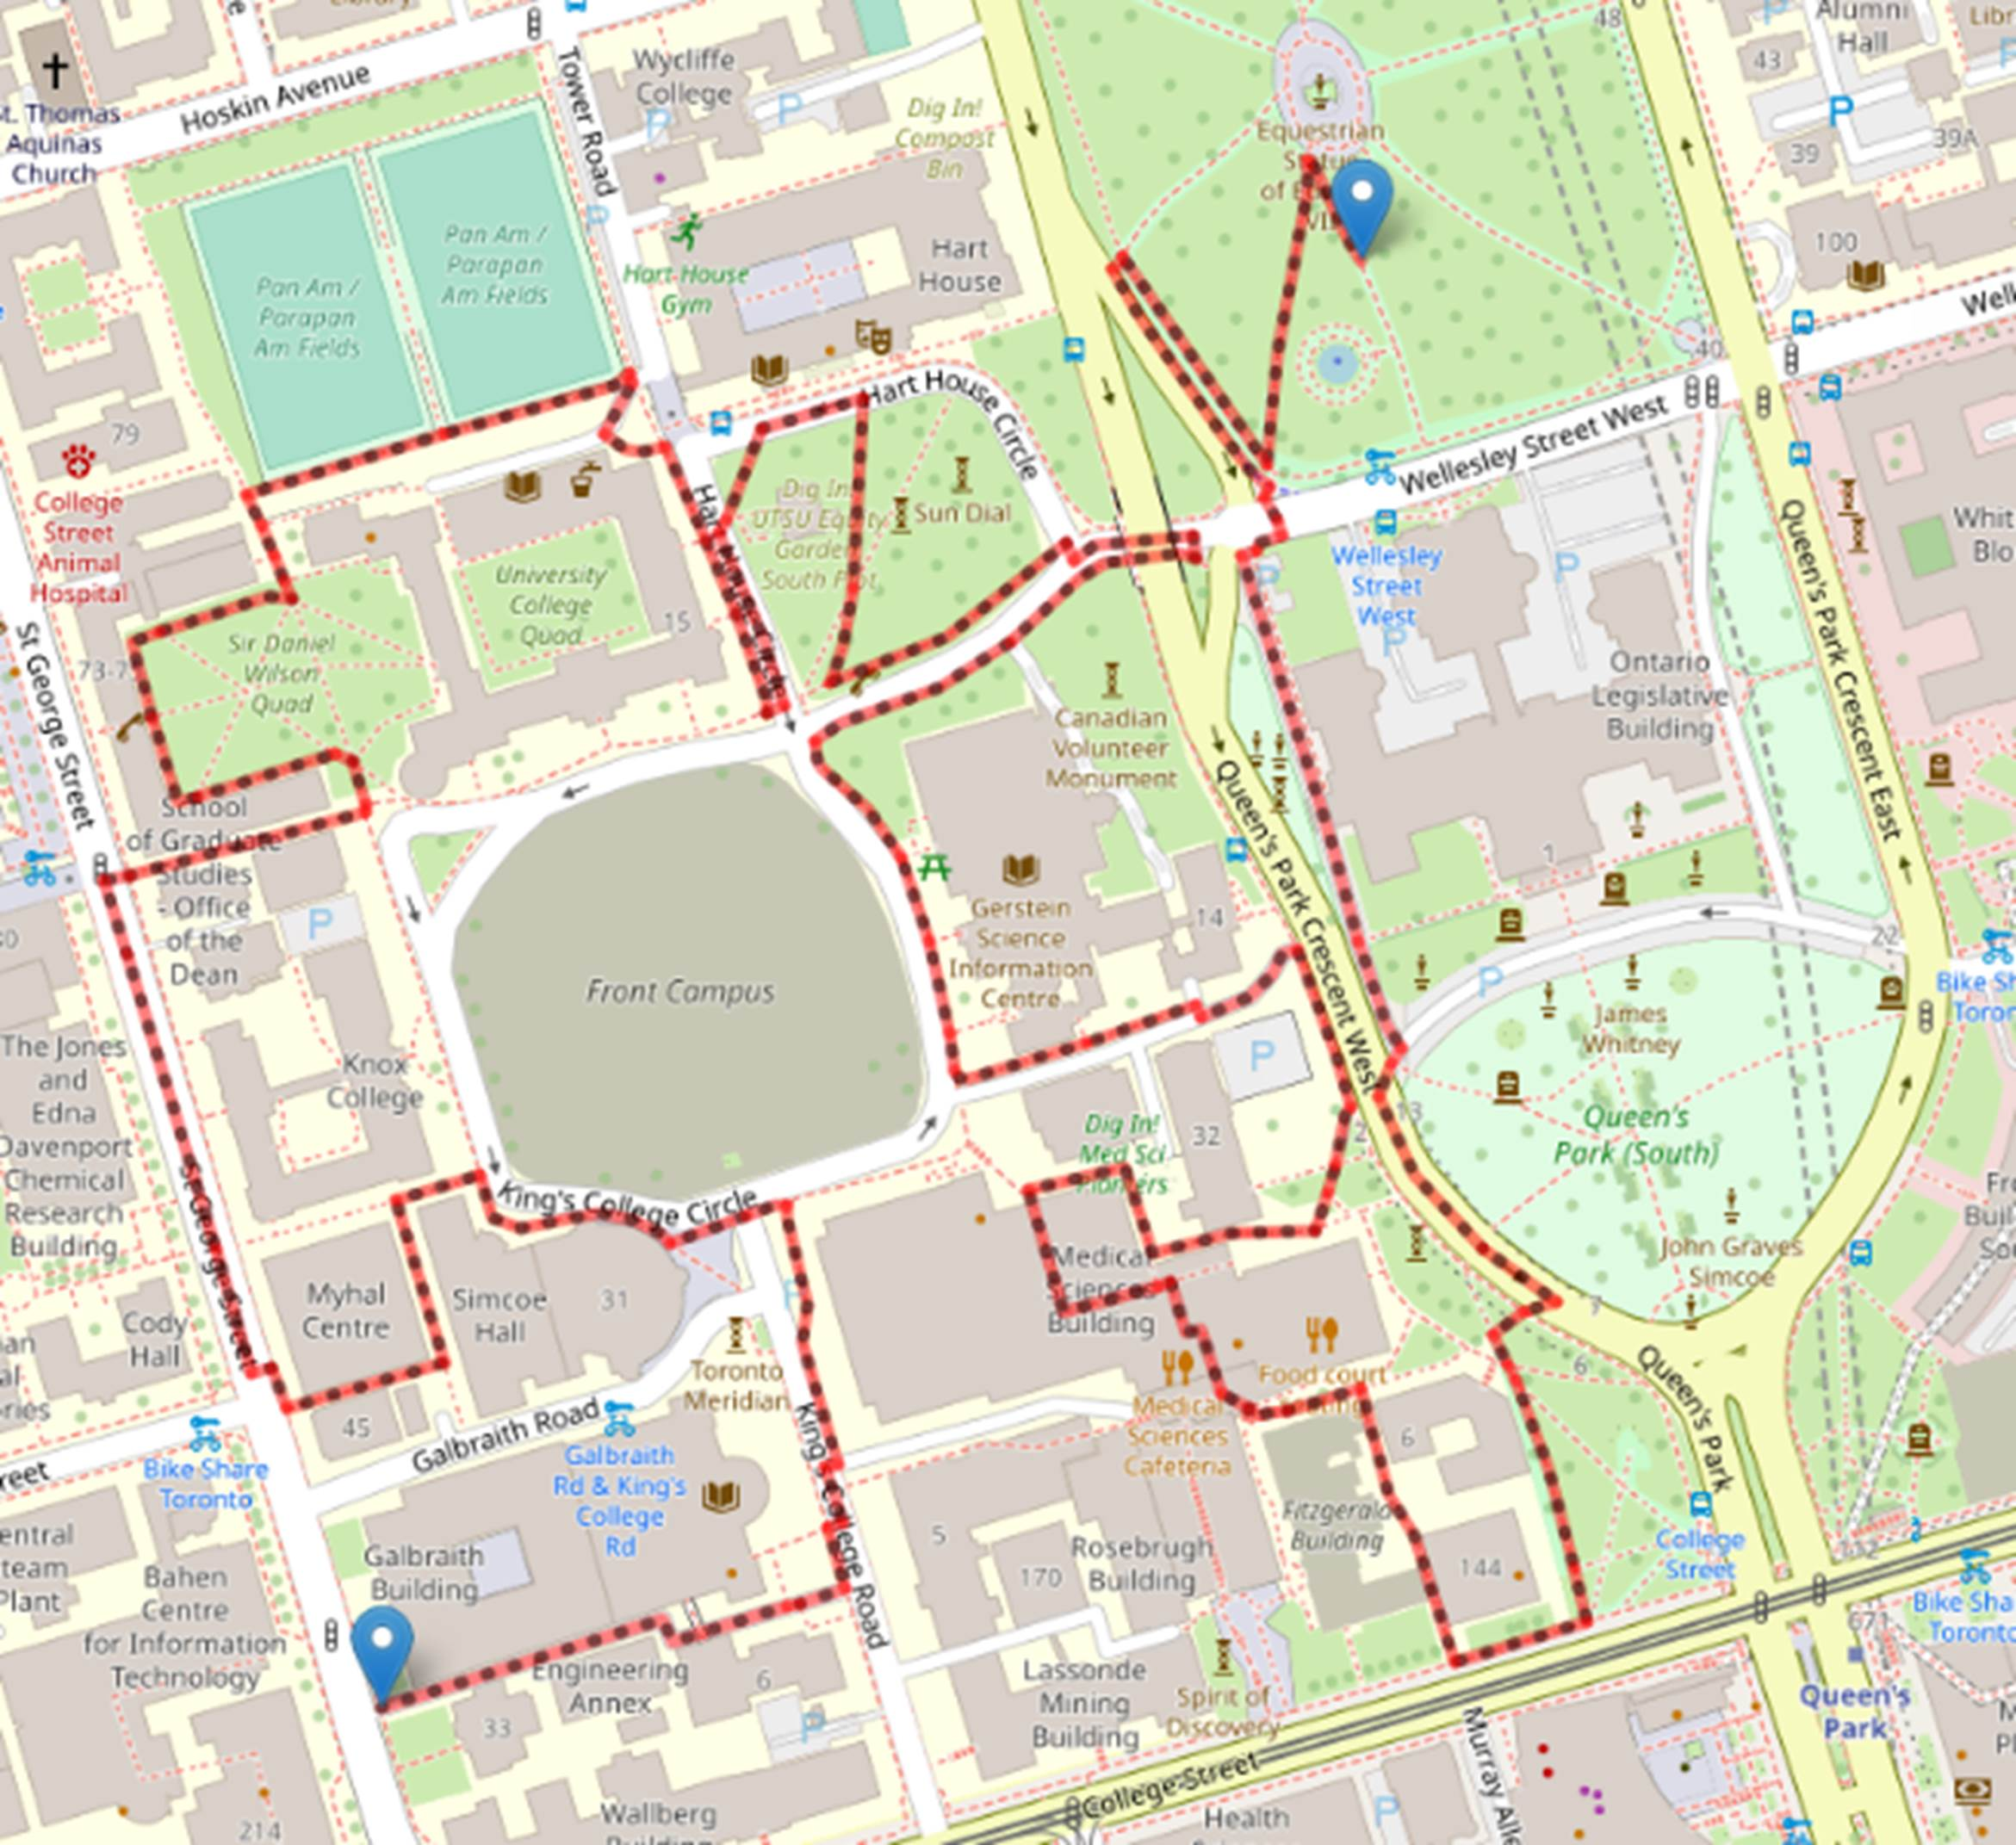
Graph Traversal Algorithms
DFS: UofT Routing Problem
source_point = (43.664527, -79.392442)
# King Edward VII Equestrian Statue
destination_point = (43.659659, -79.397669)
# Bahen Centre for Information Technology at UofT
Check: https://github.com/Optimization-Algorithms-Book/Code-Listings/blob/main/Chapter%203/Listing%203.11_comparison.ipynb
Notes:
32

Slide 33
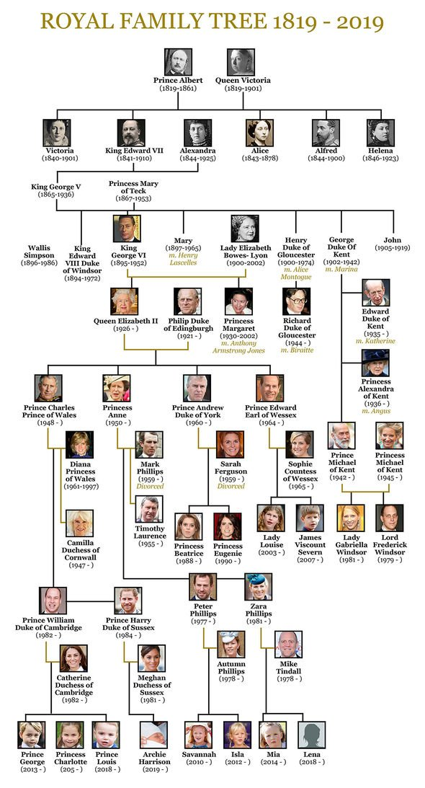

Graph Traversal Algorithms
BFS vs. DFS
Notes:
33

Slide 34
Outline
Introduction to Graphs
Graph Search Methods
Uninformed/Blind Search
Graph Traversal Algorithms
Shortest Path Algorithms
Notes:
34

Slide 35


Shortest Path Algorithms
Dijkstra’s Algorithm
Dutch computer scientist
Edsger Dijkstra
(1930 – 2002)
Notes:
35
Dijkstra (/ˈdaɪkstrə/ DYKE-strə)
Contraction hierarchies is a speed-up method optimized to exploit properties of graphs representing road networks. ... This is based on the observation that road networks are highly hierarchical.
In computer science, the method of contraction hierarchies is a speed-up technique for finding the shortest-path in a graph.

Slide 36
Shortest Path Algorithms
Dijkstra’s Algorithm
Dijkstra’s algorithm (Dynamic Programming) is a graph search algorithm that solves the single-source shortest path problem for a fully connected graph with nonnegative edge path costs, producing a shortest path tree.
Dynamic programming (DP) approaches are based on the recursive division of a problem into simpler sub-problems.
Dijkstra’s algorithm is uninformed, meaning it does not need to know the target node before hand and doesn’t use heuristic information.
Notes:
36
Dijkstra >> dɛikstra
In mathematics and computer science, dynamic programming is a method for solving complex problems by breaking them down into simpler subproblems. It is applicable to problems exhibiting the properties of overlapping subproblems which are only slightly smaller[1] and optimal substructure (described below). When applicable, the method takes far less time than naïve methods.
The key idea behind dynamic programming is quite simple. In general, to solve a given problem, we need to solve different parts of the problem (subproblems), then combine the solutions of the subproblems to reach an overall solution. Often, many of these subproblems are really the same. The dynamic programming approach seeks to solve each subproblem only once, thus reducing the number of computations. This is especially useful when the number of repeating subproblems is exponentially large.
Top-down dynamic programming simply means storing the results of certain calculations, which are later used again since the completed calculation is a sub-problem of a larger calculation. Bottom-up dynamic programming involves formulating a complex calculation as a recursive series of simpler calculations.
Dijkstra's algorithm is used for graph searches. It is optimal, meaning it will find the single shortest path. It is uninformed, meaning it does not need to know the target node before hand. In fact it finds the shortest path from every node to the node of origin.

Slide 37


Shortest Path Algorithms
Dijkstra’s Algorithm
Notes:
37

Slide 38


Shortest Path Algorithms
Dijkstra’s Algorithm
Notes:
38

Slide 39


Shortest Path Algorithms
Dijkstra’s Algorithm
Notes:
39

Slide 40

Shortest Path Algorithms
Dijkstra’s Algorithm: UofT Routing Problem
source_point = (43.664527, -79.392442)
# King Edward VII Equestrian Statue
destination_point = (43.659659, -79.397669)
# Bahen Centre for Information Technology at UofT
Check: https://github.com/Optimization-Algorithms-Book/Code-Listings/blob/main/Chapter%203/Listing%203.11_comparison.ipynb
Notes:
40

Slide 41

Shortest Path Algorithms
Bi-directional Dijkstra
area(C₁)=4πr²
area(C₂)+area(C₃)=2πr²
We reduce the search space only by a factor of ~ 2
Notes:
41

Slide 42

Shortest Path Algorithms
Bi-directional Dijkstra
Code: https://github.com/Optimization-Algorithms-Book/Code-Listings/blob/main/Chapter%203/Extras/bidirectional.ipynb
Notes:
42

